Slide 1
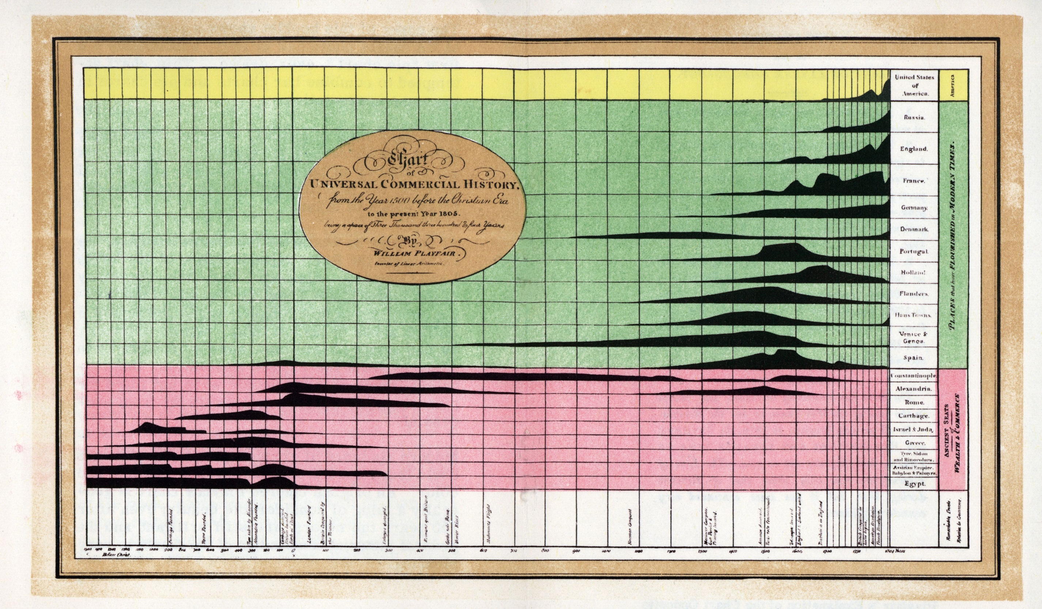
A History of Data Visualization & Graphic Communication
Michael Friendly
Howard Wainer

Slide 2
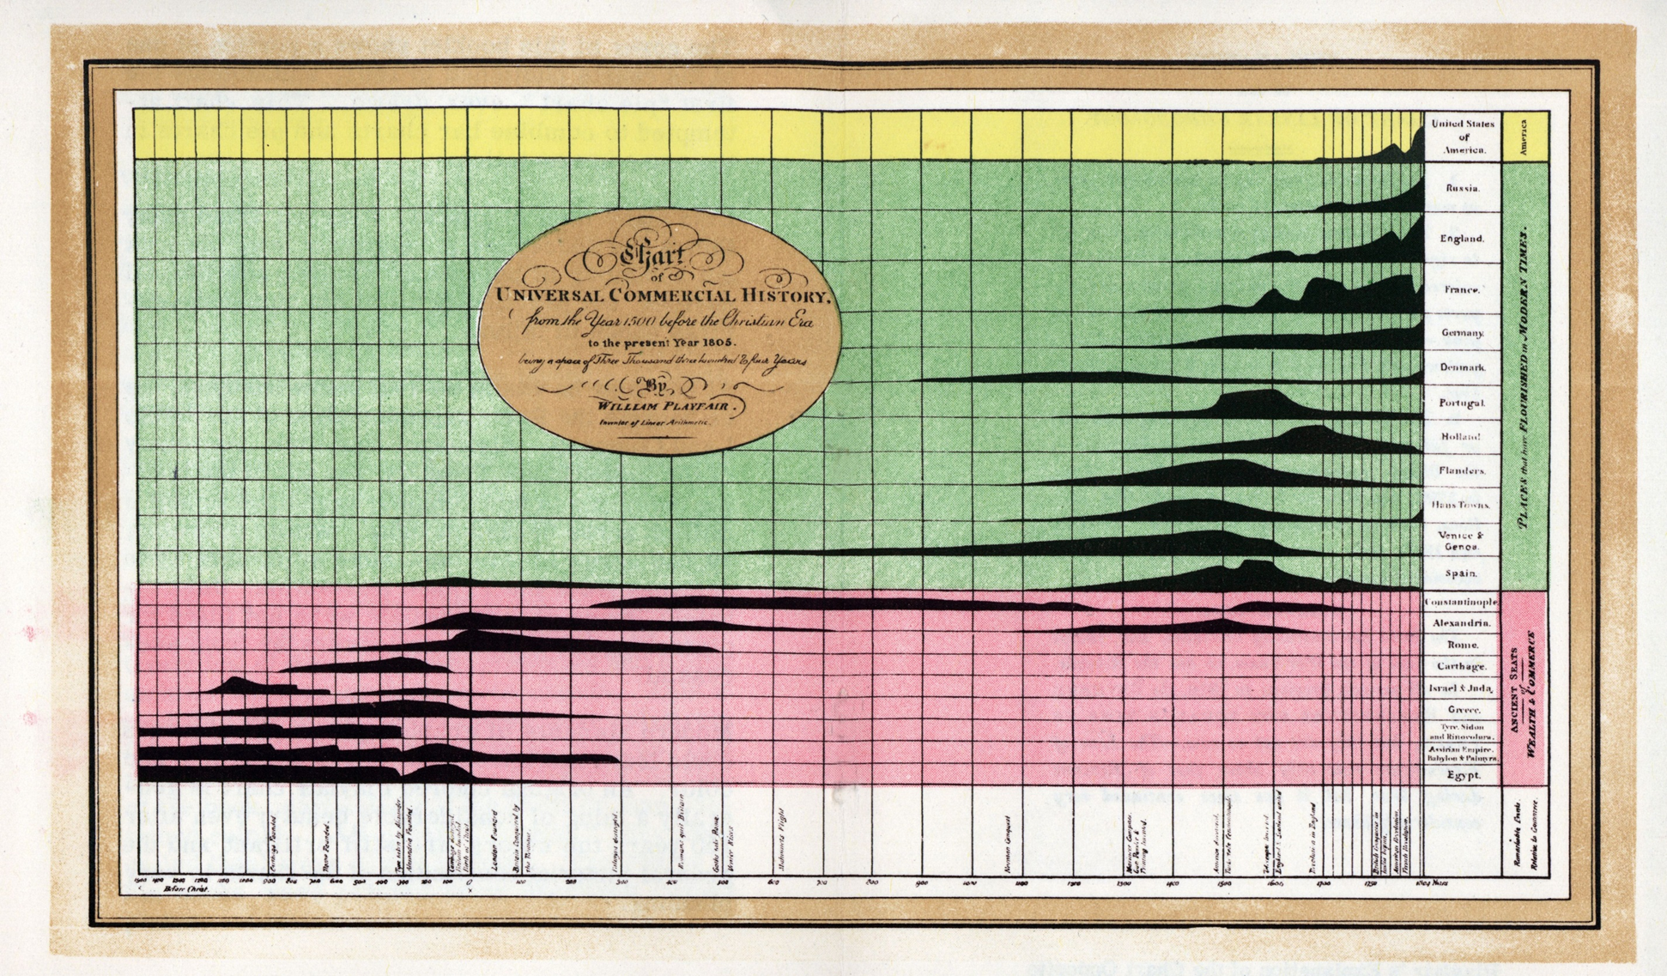
50% transparent
A History of Data Visualization & Graphic Communication
Michael Friendly
Howard Wainer

Slide 3
70% transparent
A History of Data Visualization & Graphic Communication
Michael Friendly
Howard Wainer

Slide 4
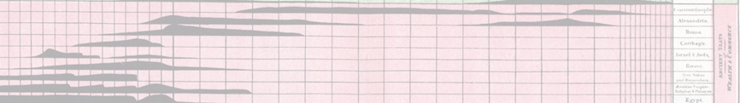
banner
A History of Data Visualization & Graphic Communication
Michael Friendly
Howard Wainer

